Slide 1
Welcome to RA-Domestic Butsuryu Control ( DBC-RA )
Home
About us
ISO Document
Activity
IT Project
Contact us
- Policy
- Organization
- ISO 9001
- ISO 18001
- ISO 45001
- Stock Reduction
- Inventory Accuracy
Indirect innovation
Butsuryu improvement
SI-SO
Cross dock
Project common
Introduction
รูปพร้อมคำบรรยายแผนก
Information
Schedule
Inventory control
Store control
Admin&
Defect control
Milk run
Package
Daily stock
Report
Layout
Report
ECN
MT
EOL
Report
Supplier milkrun
Report
Stock control
Report
Webside concern
© 2020 Developed by Genba-IT : DBC-RA & HT Dept.

Slide 2
Welcome to RA-Production Administration ( PAD )
Home
About us
ISO Document
Activity
IT Project
Contact us
- Policy
- Organization
- ISO 9001
- ISO 18001
- ISO 45001
- xxxx
- xxxx
xxxx
xxxx
Dynamic plan
MT Database
Introduction
รูปพร้อมคำบรรยายแผนก
Information
Schedule
Planning
Master
New model
xxxxx
xxxx
Tanaoroshi
ECN
Autumn
Spring
Webside concern
In-side
Out-side
© 2020 Developed by Genba-IT : DBC-RA & HT Dept.

Slide 3
Welcome to International Trade Conrtrol ( ITC )
Home
About us
ISO Document
Activity
IT Project
Contact us
- Policy
- Organization
- ISO 9001
- ISO 18001
- ISO 45001
- xxxx
- xxxx
xxxx
xxxx
xxxx
xxxx
Introduction
รูปพร้อมคำบรรยายแผนก
Information
Schedule
BOI
Import
Export
Vanning
xxxxx
xxxx
xxxxx
xxxx
xxxxx
xxxx
xxxxx
xxxx
Webside concern
In-side
Out-side
© 2020 Developed by Genba-IT : DBC-RA & HT Dept.

Slide 4
Welcome to Material Part Control ( MPC )
Home
About us
ISO Document
Activity
IT Project
Contact us
- Policy
- Organization
- ISO 9001
- ISO 18001
- ISO 45001
- xxxx
- xxxx
xxxx
xxxx
xxxx
xxxx
Introduction
รูปพร้อมคำบรรยายแผนก
Information
Schedule
PLAN
PH.1
PH.2
xxxxx
xxxx
xxxxx
xxxx
xxxxx
xxxx
Webside concern
In-side
Out-side
© 2020 Developed by Genba-IT : DBC-RA & HT Dept.

Slide 5
PAD-2

Slide 6
PAD-1

Slide 7
PAD DIV. WEBSIDE
PAD-RA

Slide 8
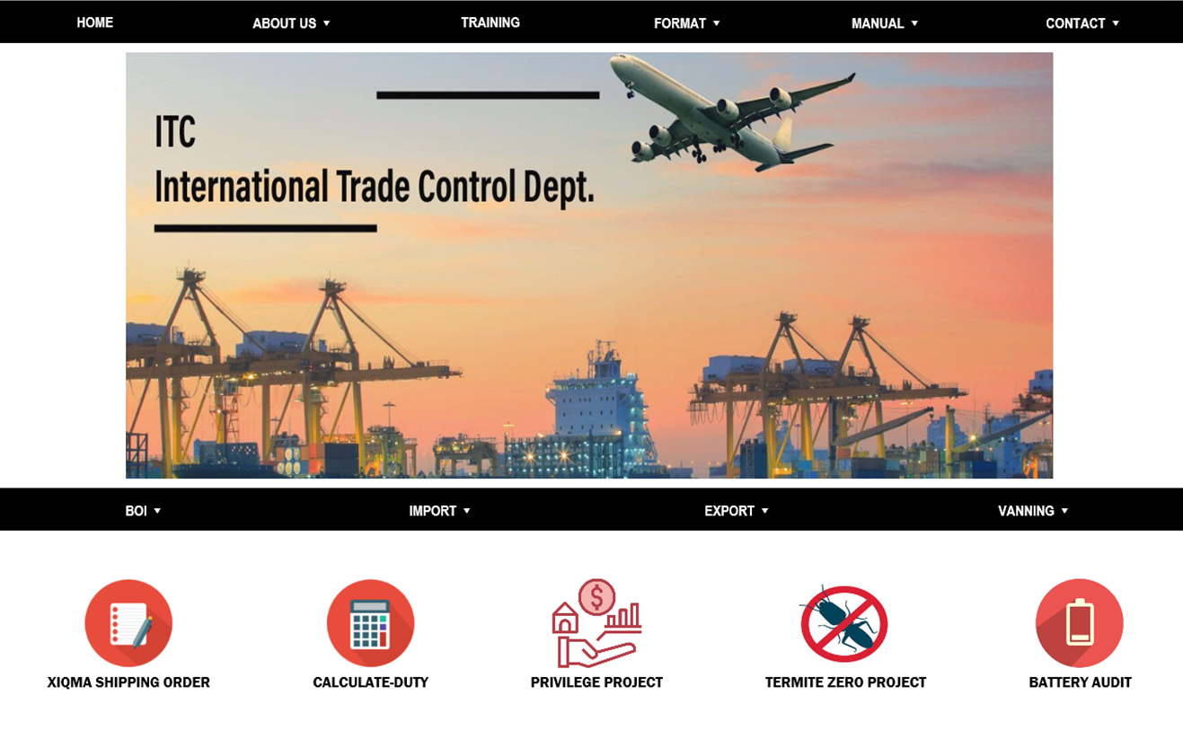
ITC-RA

Slide 9
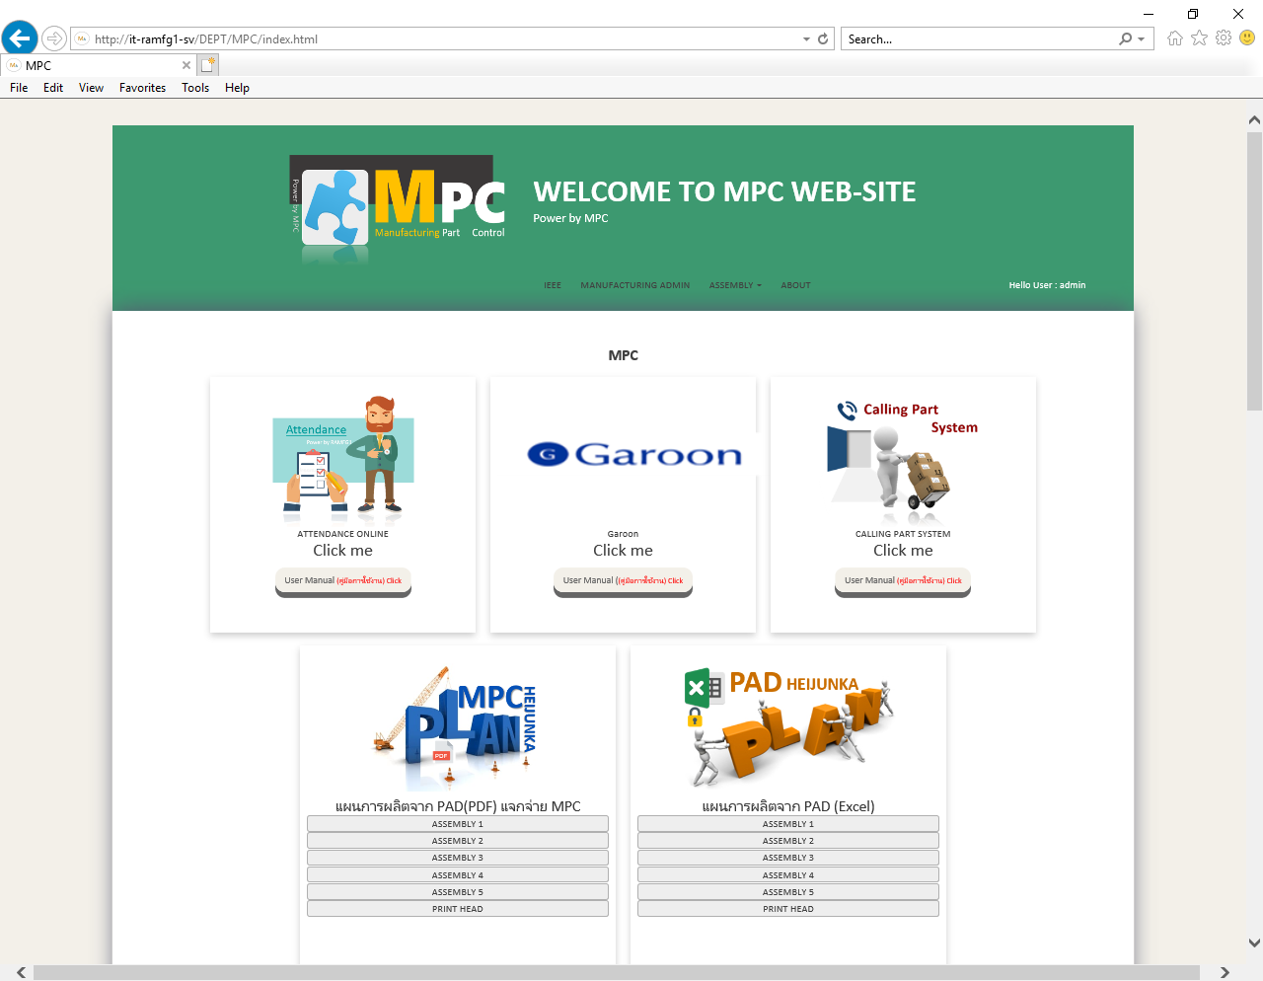
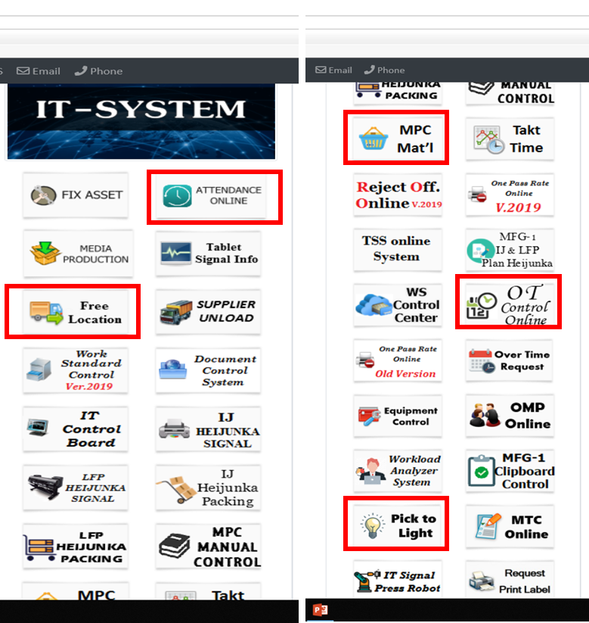
MPC-RA
MPC-HT => USE MA

Slide 10
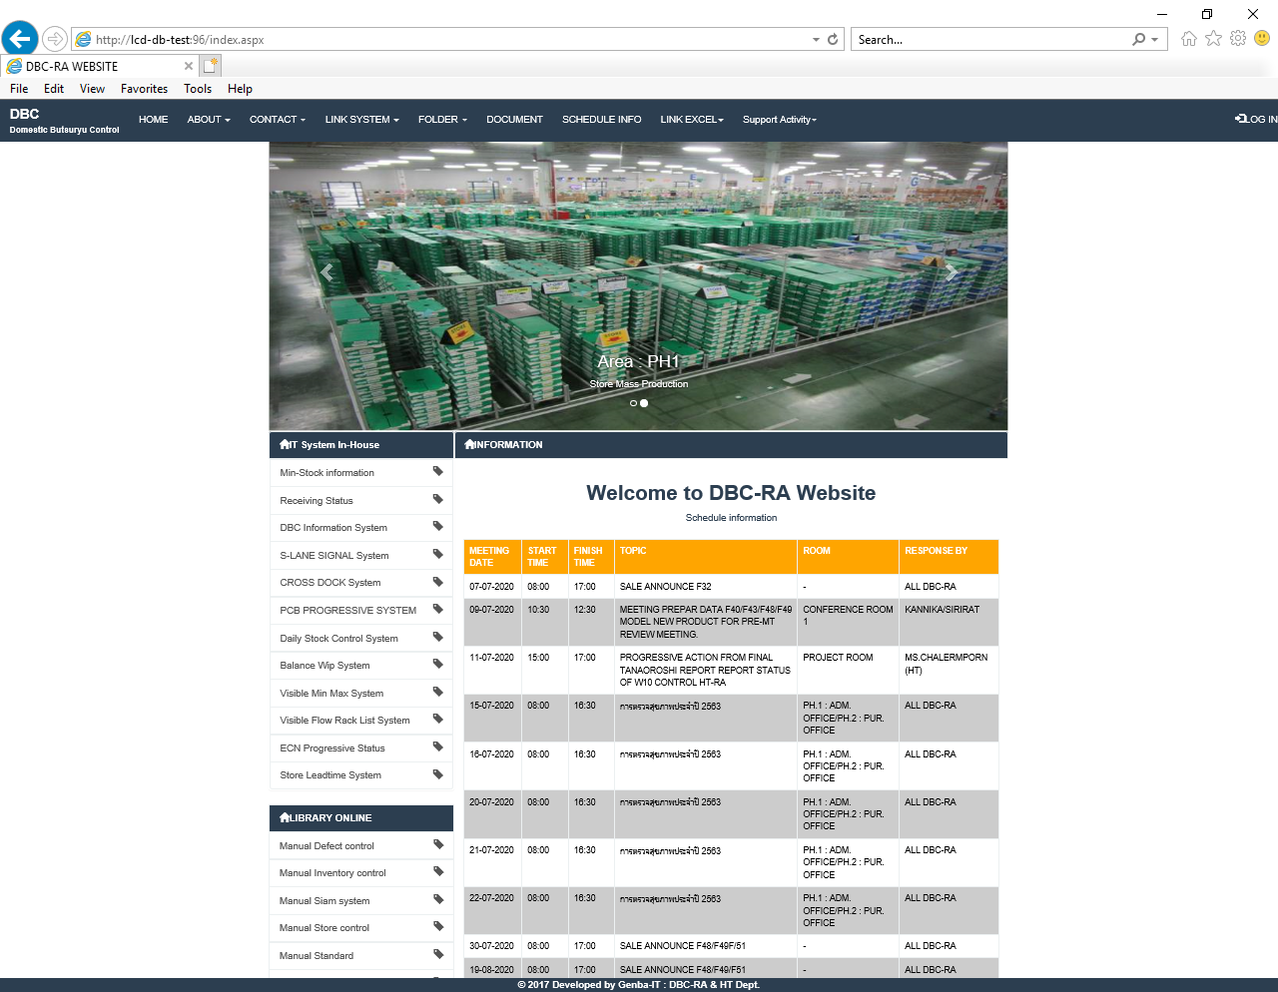
DBC-RA

Slide 11
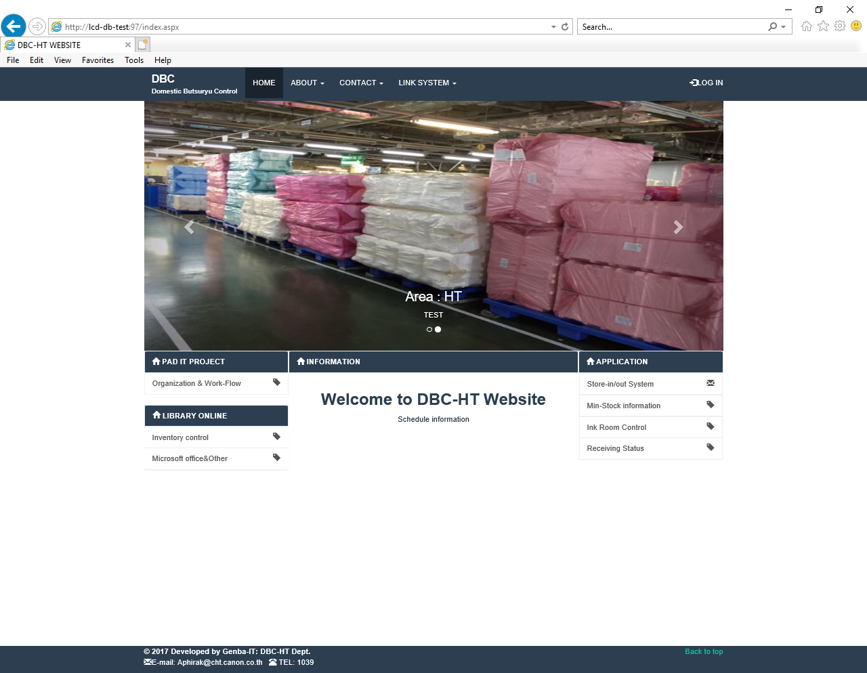
DBC-HT

Slide 12
